Slide 1

Wound Healing
Shayn Peirce-Cottler, Ph.D.
Professor of Biomedical Engineering

Slide 2
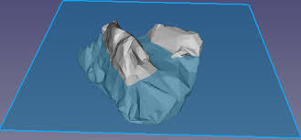
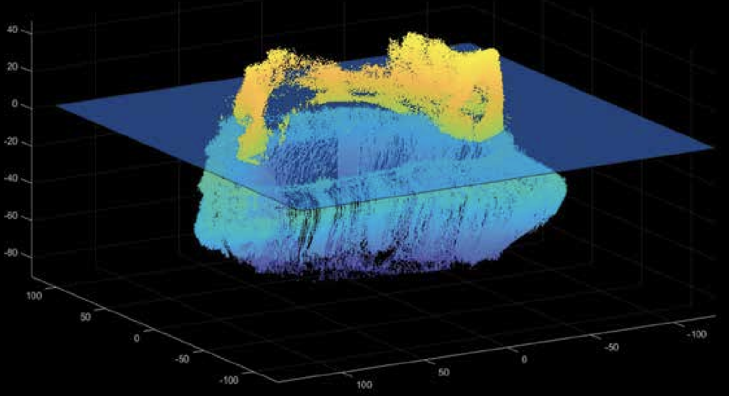
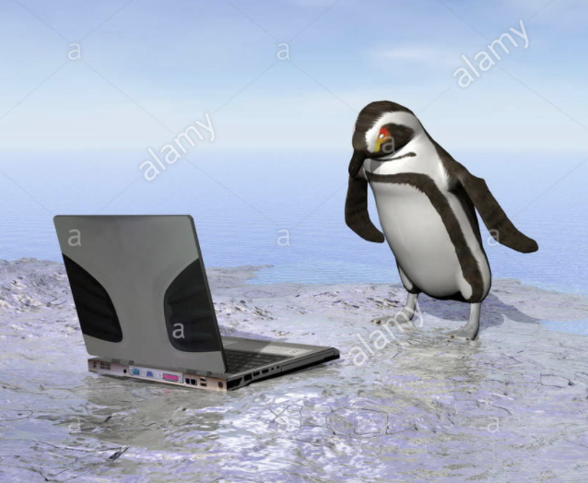
Wound Healing Models!
Shayn Peirce-Cottler, Ph.D.
Professor of Biomedical Engineering

Slide 3
Adult Wound Healing
Contraction & Remodeling
Proliferation
(granulation)
Hemostasis
Inflammation

Slide 4
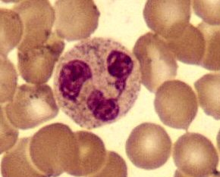
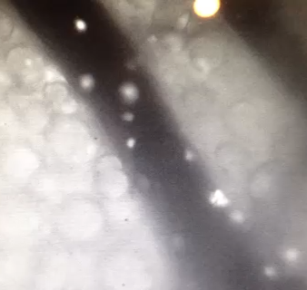
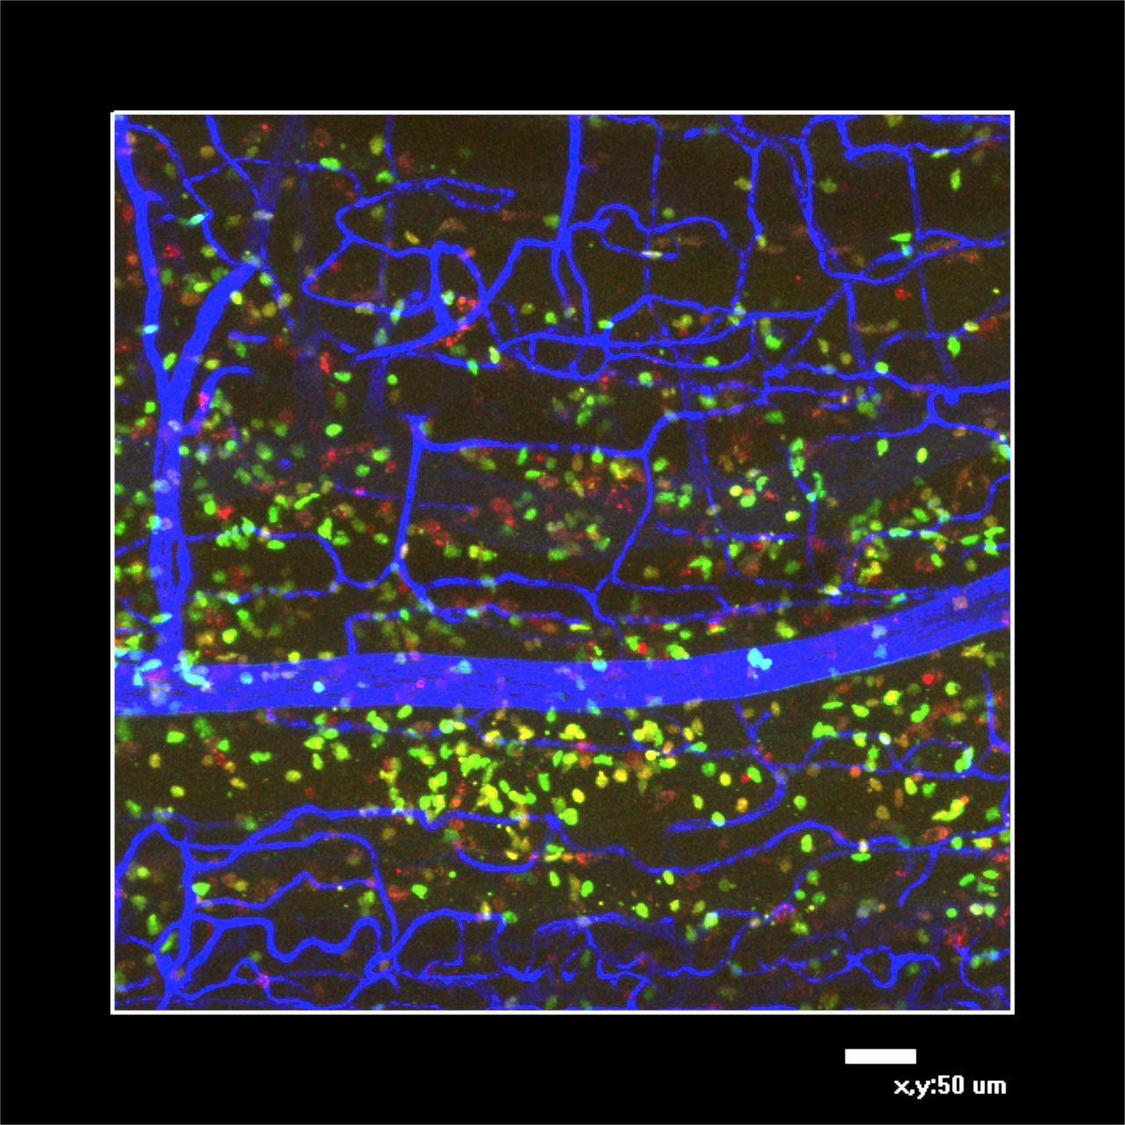
Inflammation: neutrophil (granulocyte) & macrophage recruitment
D=10μm
D=20μm
secrete chemokines!
phagocytosis!
Peirce-Cottler Lab
Peirce-Cottler Lab
Notes:
Neutrophils constitute 50% of the total circulating white blood cells. They are about 15 microns in diameter and live for approximately 6 days. Neutophils do their duty and then turn to pus and die. They have a segmented nucleus and are released from the bone marrow when there is an infection. They can ingest micro-organizms, release soluble anti-microbials, and stimulate the recruitment and activation of monocytes.

Slide 5
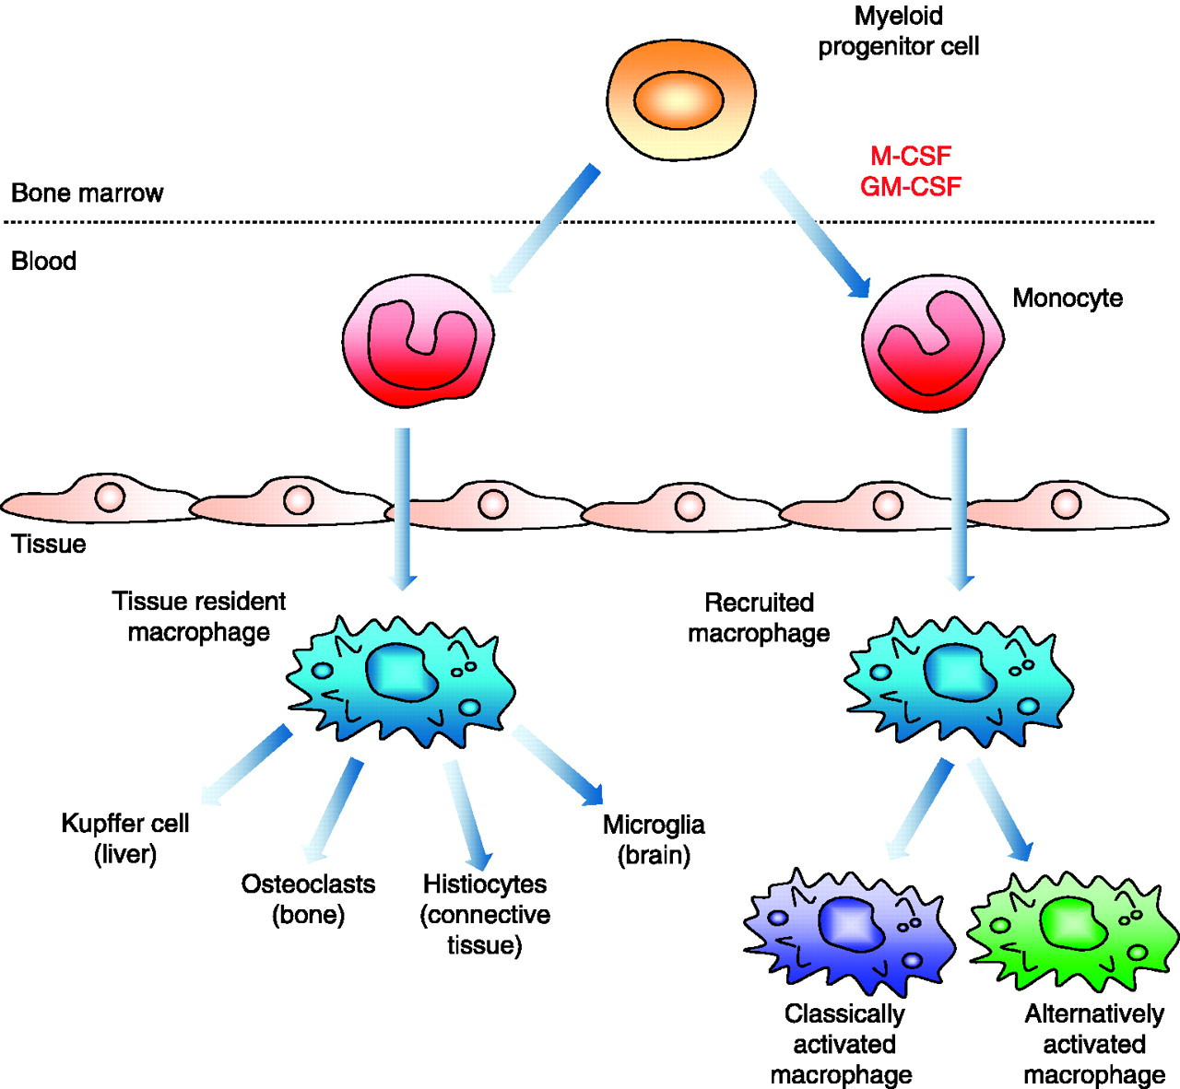
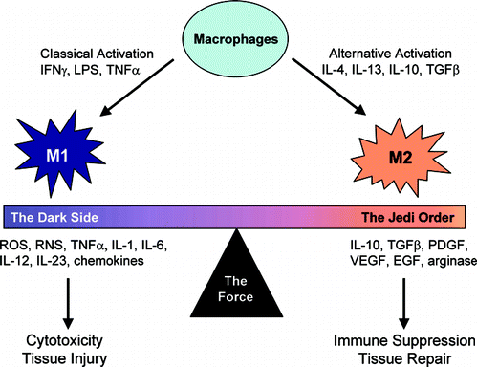
Macrophages
M1
M2
inflammation stimulation
tissue damage
tumor suppression
attenuated inflammation
tissue repair
tumor promotion

Slide 6
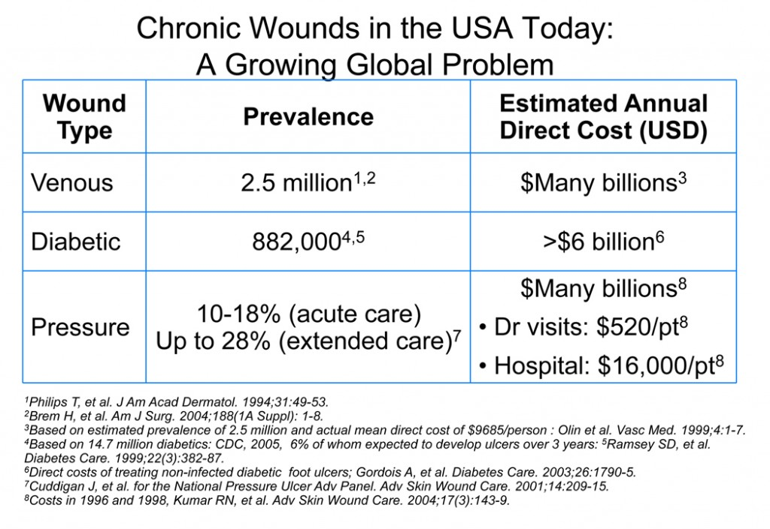
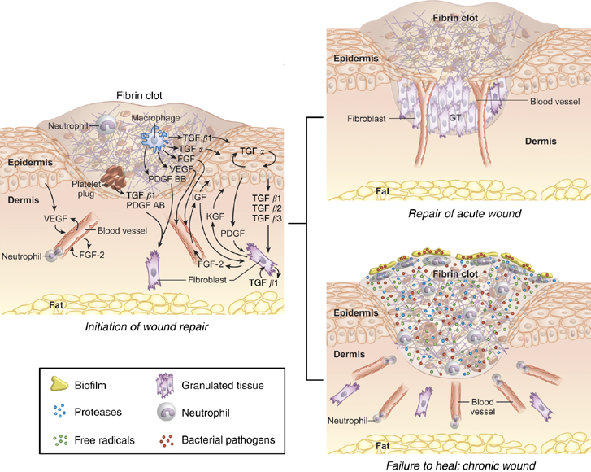
Chronic Wounds
25% of diabetic patients will develop a foot ulcer
Foot ulcers contribute to the fact that 75,000 patients need lower limb amputations annually
50% of diabetic limb amputees die within 2 years of amputation.

Slide 7
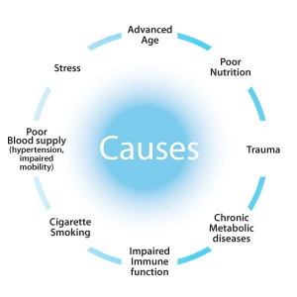
Chronic Wound Healing
Contraction & Remodeling
Dysregulated!
Proliferation
(granulation)
Dysregulated!
Hemostasis
Dysregulated!
Inflammation

Slide 8
Chronic Wounds
“Dysregulated” = accumulation of bad things that prevent the wound healing cascade from progressing normally + sick cells that can’t exhibit normal cell functions.

Slide 9
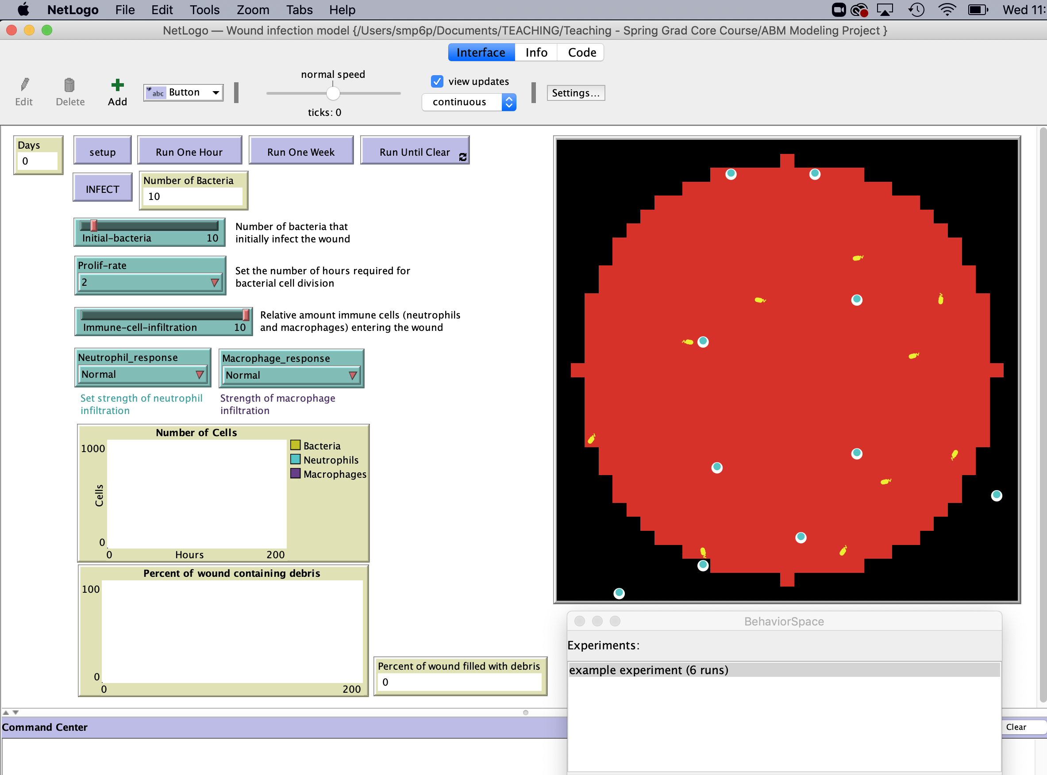



Wound Healing ABM!
agents
Top-down view of wound
neutrophil
macrophage
bacteria

Slide 10
Wound Healing ABM Project: Best Practices
Use “Behavior Space” to run a set of “experiments” (e.g. in order to do a sensitivity analysis)
Because the ABM is stochastic, run your simulations 10 times (for each model iteration) and report the average + standard deviation
Use Matlab/Excel for making your graphs (instead of Netlogo)

Slide 11
Extend the Wound Healing ABM: Project Ideas
Represent the biology with more complexity/fidelity:
Add agents to represent other cell types in the system
Add more behaviors to better represent the range of possible cell behaviors
Add rules to represent other processes and dependencies
Make the ABM predict more useful output metrics
Change the initial conditions to better represent the biological system
Simulate the case of a “diabetic” or “immunocompromised” patient
Use the ABM to identify therapies! E.g., simulate the addition of different “drugs” that change the agent behavior(s)

